Slide 1

Microsoft Purview
Data Catalog Management Automation
Accelerator Overview
September 2024

Slide 2
Table of Contents
Microsoft Purview evolution
Business Problem
User Stories
Design
Demo

Slide 3
The new Purview Data Governance Experience structure
Microsoft Purview Tenant
Catalog and Data Estate Health
Business Domain
Business Domain
Critical Data Elements
Glossary Terms
Critical Data Elements
Glossary Terms
Data Product
Data Product
Data Product
Datasets
Dashboards/Reports
Models
Datasets
Dashboards/Reports
Models
Datasets
Dashboards/Reports
Models
Technical Domains are Previously Purview “Accounts” and each tenant may have up to 5 technical domains.
Data Map
Technical Domain
Technical Domain
Technical Domain
Collection
Collection
Collection
Collection
3

Slide 4
Engagement Sizing
Simple
Data Catalog Number of Business Domains (1) Number of Data Products (1) Total number of data assets (10) Number of Glossary Terms per business domain (20) Number of Critical Data Elements (CDE) (1) Data Quality Rules (5) Health Controls (6) Data Inventory (Map) Number of Azure Data Sources (1) Number of Platform Domains (1) Number of sub-collections per Platform Domain (2) Native lineage with ADF dataflows (1) Data Access Number of out-of-the box policy based manual access (1) Other Private access mode Ingestion end-point only
Duration: 4 weeks Indicative Pricing: $100K
Medium
Data Catalog Number of Business Domains (2) Number of Data Products (4) Total number of data assets (40) Number of Glossary Terms per business domain (50) Number of Critical Data Elements (CDE) (1) Data Quality Rules (10) Health Controls (6) Data Inventory (Map) Number of Azure Data Sources (2) Number of Platform Domains (2) Number of sub-collections per Platform Domain (2) Native lineage with ADF dataflows (1) Data Access Number of out-of-the box policy based manual access (1) Custom integration through Power Automate and AAD entitlement packages Other Private access mode Ingestion end-point only
Duration: 6 weeks Indicative Pricing: $150K

Slide 5
High Level Updates New Next Gen Features
Business Domains - Business domains are durable subject areas used to organize a physical data estate. Subject areas can be business functions such as finance, hr and sales, master data domains such as customer and product, or any boundary for governance at your company.
Data Products - A data product is a packaged offering that groups together various data assets, such as tables, files, and Power BI reports. These assets are associated with a specific use case and are intended to be shared with data consumers within the enterprise.
OKR’s - Are trackable business objectives tied to business domains and data products to emphasize the value of business data1. They help bridge the gap between the business goals and the data estate.
CDE’s - Critical Data Elements (CDEs) are logical groupings of important columns across tables in your data sources. These groupings allow you to strategically focus your governance efforts where they’ll have the most impact
Data Quality – This is a comprehensive solution that empowers business domain and data owners to assess and oversee the quality of their data ecosystem.

Slide 6
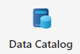
Business Domains in Data Catalog It provides context for your data assets and make it easier scale data governance practices
A business domain is a boundary that enables the common governance, ownership, and discovery of data products and business concepts like glossary terms, OKRs, or critical data. The goal is to empower a business domain owner to manage their data products and concepts, and establish rules for their access, use and distribution.
The diagram below shows the elements which Business domains consists of.
Business Domains
Data Products
OKRs
Glossary Terms
Custom Attributes
Critical Data Elements
Notes:
Asset insights: A report on the data estate and source-type distribution. You can view by source type, classification, and file size. View the insights as a graph or key performance indicators (KPI).
Scan insights: This report provides information on the health of your scans (successes, failures, or canceled).
Glossary insights: A status report on the glossary to help users understand the distribution of glossary terms by status, or to view how the terms are attached to assets.
Classification insights: A report showing where classified data is located. It allows security administrators to understand the types of information found in their organization's data estate.
Sensitivity insights: This report focuses on sensitivity labels that are found during scans. Security administrators can make use of this information to ensure security is appropriate for the data estate.
File extension insights: Detailed reporting on file extensions or file types found during scans. You can use this to understand the number of files of each type that exist. It also indicates where these files are located and if they can be scanned for sensitive information.

Slide 7
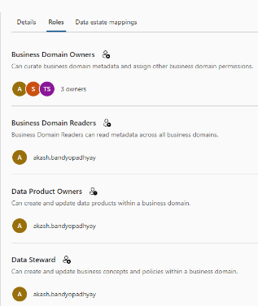
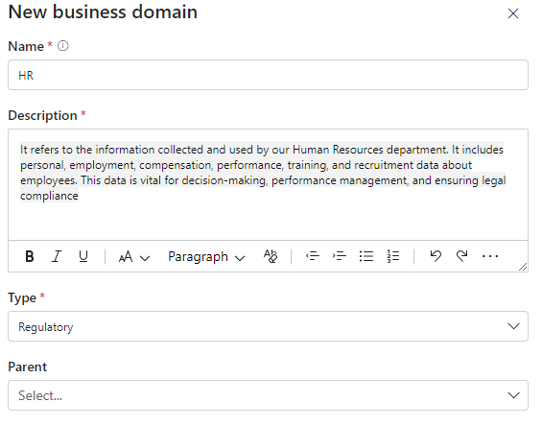
Creation of Business Domains Managing data governance practices at scale
As business domains are created it enables the federation of data governance and ensure the right experts can contribute to the data catalog in the domains of their expertise.
In the roles tab of the business domain the owner can empower business and data experts to build out the content of the domain.
This is the primary location for permissions management in the Data catalog

Slide 8
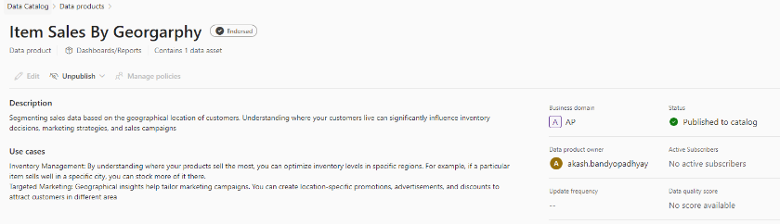
Data Products Managing data governance practices at scale
A data product provides context by combining related data assets under a common business concept. It includes:
Name: Descriptive title for the data product.
Description: Explanation of the use case or purpose.
Owners: Responsible individuals or teams.
Associated Data Assets: The actual data tables, files, or reports
For example, a data scientist creating a data model can create a data product that lists all the assets used for that model. This approach simplifies discovery, promotes reuse, and enhances collaboration across domains.
The data product can house many assets depending on the use of the data. You can add one or many assets, however the data is intended to be consumed.

Slide 9
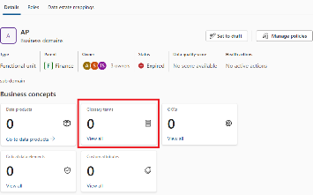
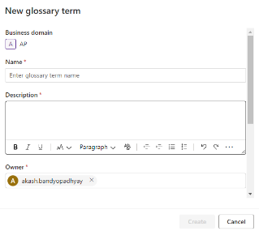
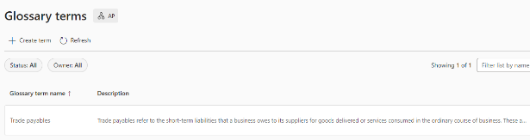
Creation of Glossary Terms Managing data governance practices at scale
Glossary terms are active values that provide context, but also apply policies that determine how your data should be managed, governed, and made discoverable for use.
Add common terms and phrases that are used by business teams to explain how the experts communicate about the business.

Slide 10
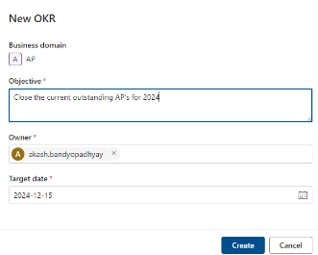
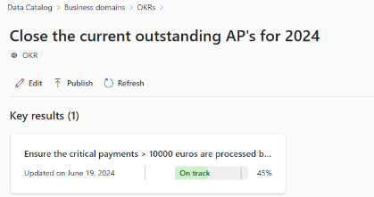
Creation of OKRs Managing data governance practices at scale
OKRs (objectives and key results) in Microsoft Purview are trackable business objectives tied to business domains and data products to emphasize the value of business data.
OKRs have several parts:
Owners - the users responsible for maintenance of the objective
Definition - An overarching description of your objective, which can be as broad as “empower every person and every organization on the planet to achieve more”, or as specific as "use marketing campaigns to increase sales in the first quarter.“
Target date - when you expect to achieve your goal.
Key results - these are the measurable, time-bound goals associated with your objective, and should be how you track progress toward your objective.

Slide 11
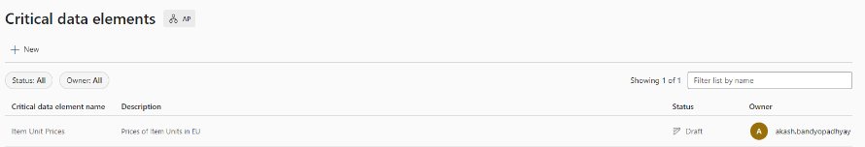
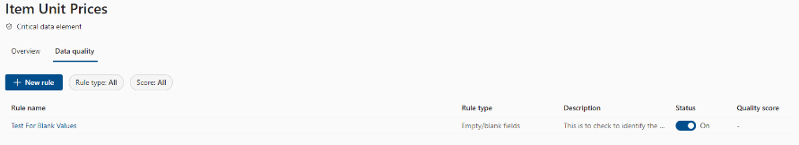
Creation of CDE’s Managing data governance practices at scale
Microsoft Purview Data Quality offers an integrated solution for measuring the quality of CDEs. It ensures that these key data elements meet required standards for accuracy, completeness, consistency, and integrity. Organizations can establish specific quality thresholds that CDEs must meet to maintain their quality. These thresholds apply at the logical CDE level and trickle down to all individual columns within the CDE. Data quality rules encompass aspects like validation, cleansing, standardization, and enrichment. For instance, rules might specify that customer addresses must be standardized to a specific format or that employee IDs must adhere to a certain pattern.
By proactively monitoring and managing the quality of critical data elements, organizations ensure reliability, accuracy, and fitness for purpose. This not only enhances decision-making processes but also mitigates risks associated with data errors or inconsistencies, ultimately driving better business outcomes.

Slide 12
Business Problem

Slide 13
To provide an automated way to bulk load Business Concepts in a new Microsoft Purview SaaS instance

Slide 14
Accelerator overview
Value:
Accelerate customer’s migration from Azure Purview to Microsoft Purview. Leverage customer’s existing Data Governance artefacts and avoid duplicate effort.
Features:
Simple yet comprehensive set of automation scripts to bulk upload Microsoft Purview Data Catalog business concepts
Minimal configuration
Customizable
Building Blocks:
Microsoft Purview Data Catalog APIs
Modular Python script for each Business Concept
Bulk upload csv schema for each Business Concept

Slide 15






Business Concept Bulk Upload Design
Azure Data Lake Storage Gen2
Data Catalog Management APIs
Azure Databricks Notebook OR Microsoft Fabric Spark Notebook
Microsoft Purview
2. Engineer invokes business concept script
3. Business user Confirm on updates on Catalog
CSV file
1. Business user uploads Business concept csv file

Slide 16
Environment Perquisites and Set-up
Network enablement : Azure Databricks/Fabric Notebooks should be able to make Microsoft Catalog API calls to the Microsoft Purview Tenant service through an Entra Service Principal (SPN)
Access needed for SPN
Microsoft Purview Catalog Role : Business Domain Creator
Entra Graph API Directory.Read.All (Application), User.Read (Delegated), User.Read.All (Application)
Azure Blob Storage : Storage Account Blob Reader
Azure Key Vault : Key Vault Reader access

Slide 17
8. Business Concepts Migration User Stories
Business Concept | User Story
Business Domains | As a platform engineer, I should be able to bulk load business domains to a Purview SaaS instance.
Data Products under Business Domains | As a platform engineer, I should be able to bulk load data products under specific domains. If the data product is already present, then do not update.
Data Assets under Data Products | As a platform engineer, I should be able to bulk upload data assets under specific data products. If the data assets already is already present under a data product, then do not update

Slide 18
8. Business Concepts Migration User Stories (contd.)
Business Concept | User Story
Glossaries under business domains | As a platform engineer, I should be able to bulk upload glossaries under specific business domain. If the glossary term is already present under a business domain, then do not update. Should be able to associate between Glossary terms (parent/child, synonyms, related) Should be able to associate with Data Products Should be ablet to associate with CDEs (Future Backlog Item)
Critical Data Elements (CDE) | As a platform engineer, I should be able to bulk upload CDE Should be able to associate between CDE and data asset columns
OKR | As a platform engineer, I should be able to bulk upload OKRs
Custom Attributes (Future Backlog Item) | As a platform engineer, I should be able to associate Custom Attributes with all concepts (Data products, OKR, CDE)

Slide 19
User story #1 : Bulk upload Business Domains
Business Domain CSV schema
business_domain_name | type: "string“ Example: “Product" | The name for the Business Domain
business_domain_email_owners | Type:”string” Example; “a@abc.com,b@abc.com” | Comma separated emails of Owners
business_domain_status | "type": "string", Allowed Values: "Published", "Draft", "Expired" | The state to share if the domain is published for sharing, in review, expired, draft.
business_domain_type | type": "string", Allowed Values: FunctionalUnit","LineOfBusiness","DataDomain","Regulatory","Project" | The type of the domain
business_domain_description | type:”string” Example: “This is the Product business domain” | Rich text field of the characteristics of the domain and who they are.
business_domain_parent | type: "string", Example: “Finance" | (Optional) Existing Business Domain name
Script logic –
For each row, checks if Business Domain with the same name already exist. If present, new business domain request will not be processed. Success/failure message will be logged for that row.
For each row, if the business_domain_email is not found in Entra, that row will not be processed. Success/failure message will be logged for that row.
For each row, if any other error is returned by API, the message will be logged for that row.
After adding the business domain, a separate call will be made to update the policy store to add the users specified in business_domain_email_owners as Business Domain Owners

Slide 20
User story #2 : Bulk upload Data Products
Data Product CSV schema
dp_name | type: "string“ Example: “Customer Retention" | Name of the Data Product
business_domain_name | type: "string“ Example: “Product | To be provided as display name of existing business domain.
dp_status | "type": "string", Allowed Values: "Published", "Draft", "Expired" | The state to share if the data product is published for Draft, Published, Expired.
dp_type | type": "string", Allowed Values: "Master","Reference","Analytical","AI","Dataset","MasterDataAndReferenceData","BusinessSystemOrApplication","ModelTypes","DashboardsOrReports","Operational" | The type of the Data Product
dp_description | type:”string” Example: “This is the dta produc for Product business domain” | Rich text field that enables user to add any needed content
dp_businessUse | type: "string", Example: “Forecasting of future revenue. Sales trend analysis." | This is a business description of the reason for the data product creation. This may connect to an objective and key result that is defined in a domain or it may be something more generic like to see what value it can create to users.
dp_owners | Type:”string” Example; “a@abc.com,b@abc.com” | Comma separated emails of Owners
dp_updateFrequency | type:”string”, Allowed Values: "Daily","Weekly","Monthly","Quarterly","Yearly" | The frequency of the data product update.
Script logic –
For each row, checks if Data Product stated in the dp_name column exists across all business domains. If not present, new Data Products request will not be processed. Success/failure message will be logged for that row.
For each row, if the business_domain_name
is not found in existing Business Domains list, that row will not be processed. Success/failure message will be logged for that row.
For each row, if the dp_owners is not found in Entra, that row will not be processed. Success/failure message will be logged for that row.
For each row, if any other error is returned by API, the message will be logged for that row.

Slide 21
User story #3 : Bulk upload Data Assets to Data Products
Data Product CSV schema
data_asset_fqn | type: "string“ Example: “mssql://clothesrusserver.database.windows.net/ClothesRUs_POS_Server/SalesLT/Customer" | Fully qualified domain name that uniquely identifies the asset in the data map
business_domain_name | type: "string“ Example: “Operations | To be provided as display name of existing business domain.
data_asset_purview_account_name | "type": "string", Example: “prvw-clothesrus" | The Purview account name
dp_name | type": "string", Allowed Values: "Master","Reference","Analytical","AI","Dataset","MasterDataAndReferenceData","BusinessSystemOrApplication","ModelTypes","DashboardsOrReports","Operational" | The name of the Data Product to associate the asset
Script logic –
For each row, query the data map to get the data map asset id.
Using the data map asset it checks if the asset is present in the Data Catalog. If not present, then create it and get the data catalog asset id. If present, then get the existing data catalog asset id
Using the data catalog asset id create relationship between the Data Product and the catalog asset
For each row, if any other error is returned by API, the message will be logged for that row.

Slide 22
User story #4 : Bulk upload Glossaries
Data Product CSV schema
glossary_term_name | type: "string“ Example: “Customer Retention" | Name of the Glossary Term
glossary_term_description | type:”string” Example: “This is the glossary term” | To be provided as display name of existing business domain.
glossary_term_status | "type": "string", Allowed Values: "Published", "Draft", "Expired" | The state to share if the data product is published for Draft, Published, Expired.
glossary_term_owner | Type:”string” Example; “a@abc.com,b@abc.com” | Comma separated emails of Owners
glossary_term_expert | Type:”string” Example; “a@abc.com,b@abc.com” | Comma separated emails of expert
glossary_term_database_admin | Type:”string” Example; “a@abc.com,b@abc.com” | Comma separated emails of database_admin
glossary_term_acronyms | Type:”string” Example; “glossary_term_acronyms” | Comma separated emails of Owners
business_domain_name | type: "string“ Example: “Product" | The name for the Business Domain
glossary_term_parent_term | type: "string", Example: “Customer" | (Optional) Existing Parent glossary name
glossary_term_synonyms | type: "string", Example: “Synonym of customer" | (Optional) Existing Synonym of glossary name
glossary_term_related | type: "string", Example: “Related to customer" | (Optional) Existing Related to glossary name
glossary_term_data_product | type: "string", Example: “Customer data product" | (Optional) Existing data product
Script logic:
For each row in the glossary terms:
Check if the Data Product exists: It checks if the glossary_term_data_product exists by merging with data_products. If it doesn’t exist, the row is not processed, and the success/failure is logged.
Check if business_domain_name is valid: The script verifies if the glossary_term_business_domain_uuid exists in the list of business domains (df_sources). If not found, the row will not be processed, and the result is logged.
Check owners and contacts: For each row, it checks if glossary_term_owner, glossary_term_expert, and glossary_term_database_admin are mapped correctly (by retrieving their user IDs). If not found, the row will not be processed, and the outcome is logged.
Create or update glossary terms: If all checks pass, it constructs and sends a payload to create/update the glossary term and handle synonyms or relationships (like related terms and data products).
Handle API errors: If an error occurs during the API interaction (e.g., bad requests, validation errors), the error message is logged, and the row is skipped.

Slide 23
User story #5 : Bulk upload Critical Data Element (CDE)
Data Product CSV schema
cde_name | type: "string“ Example: “EmployeeID" | Name of the Critical Data Element (CDE)
cde_status | "type": "string", Allowed Values: "Published", "Draft", "Expired" | The state to share if CDE is published for Draft, Published, Expired.
cde_description | type:”string” Example: “This is the CDE for Product business domain” | Rich text field that enables user to add any needed content
cde_owner | Type:”string” Example; “a@abc.com,b@abc.com” | Comma separated emails of Owners
cde_fqdn | type:”string”, Example : "https://clothesrusdatalake.dfs.core.windows.net/humaresources/employees/Employee.csv" | The uniquely identifiable name of the data map asset
cde_column_name | type:”string”, Example : “EmployeeID" | The column name from the data map asset that needs to be mapped to the CDE
business_domain_name | type: "string“ Example: “HR | To be provided as display name of existing business domain.
Script logic –
For each row, checks if CDE stated in the cde_name column exists in the business domain business_domain_name. If not present, new CDE request will not be processed. Success/failure message will be logged for that row.
For each row, if the business_domain_name
is not found in existing Business Domains list, that row will not be processed. Success/failure message will be logged for that row.
For each row, if the cde_owners is not found in Entra, that row will not be processed. Success/failure message will be logged for that row.
For each row’s cde_fqdn, query the data map to get the data map asset id.
Using the data map asset it checks if the asset is present in the Data Catalog. If not present, then create it and get the data catalog asset id. If present, then get the existing data catalog asset id
Using the data catalog asset id create relationship between the cde_name and the column specified by cde_column_name in catalog asset
For each row, if any other error is returned by API, the message will be logged for that row.

Slide 24
User story #6 : Bulk upload OKR
Data Product CSV schema
definition | type: "string“ Example: “OKR for customer satisfaction measurement" | Name of the OKR
domain | type: "string“ Example: “Sales” | To be provided as display name of existing business domain.
status | "type": "string", Allowed Values: "Published", "Draft", "Expired" | The state to share if the data product is published for Draft, Published, Expired.
targetDate | type": "string", Example: “12-31-2024" | Target data of OKR completion. Format mm-dd-YYYY
owner | Type:”string” Example; “a@abc.com,b@abc.com” | Comma separated emails of Owners
Script logic –
For each row, checks if OKR with the definition stated in the definition column exists across business domain specied in domain. If present, new OKR request will not be processed. Success/failure message will be logged for that row.
For each row, if the domain is not found in existing Business Domains list, that row will not be processed. Success/failure message will be logged for that row.
For each row, if the owner is not found in Entra, that row will not be processed. Success/failure message will be logged for that row.
For each row, if any other error is returned by API, the message will be logged for that row.

Slide 26
Differences between Azure and Microsoft Purview
Managed attributes created and applied to assets per environment
Common Managed Attributes will need to be applied to assets in each platform
Purview Workflows used for custom data access requests
Glossaries defined per domain in each environment
Custom Classification labels created and applied to assets in each environment

Slide 27
Post Account merge Business Concepts merge activities
Move Managed Attributes (Data Map to Custom Attributes?)
Workflows? – Obsolete in the new experience
Scans?
Custom classifications – Merge from multiple accounts to the single account
Scan Patterns

Slide 28
Post Account merge Business Concepts merge activities
Bulk uploads:
Business Domains
As a platform engineer, I should be able to bulk load business domains to a Purview SaaS instance.
Data Products under Business Domains
As a platform engineer, I should be able to bulk load data products under specific domains. If the data product is already present, then update/do not update?
Data assets under Data Products
As a platform engineer, I should be able to bulk upload data assets under specific data products. If the data assets already is already present under a data product, then update/do not update?
Glossaries under business domains
As a platform engineer, I should be able to bulk upload glossaries under specific business domain. If the glossary term is already present under a business domain, then update/do not update?
Should be able to associate between Glossary terms (parent/child, synonyms, related)
Should be able to associate with Data Products
Should be ablet to associate with CDEs (coming soon)
Critical Data Elements (CDE)
As a platform engineer, I should be able to bulk upload CDE
Should be able to associate between CDE and data asset columns
OKR’s
As a platform engineer, I should be able to bulk upload OKRs
Custom Attributes (coming soon)
Association with all concept (Data products, OKR, CDE)

Slide 29
Microsoft Purview & Priva
Product Vision:
Microsoft Purview brings together solutions from compliance and data governance portfolios
Risk & compliance
For risk, compliance, and legal teams
Data Map
Data Sharing
Data Catalog
Data Estate Insights
Microsoft Purview
Information Protection
Data Loss Prevention
Data Lifecycle Management
Data Connectors
Insider Risk Management
eDiscovery
Audit
Records Management
Communication Compliance
Compliance Manager
Unified data governance
For data consumers, data engineers, data officers

Slide 30



Purview Data Governance Evolution
Classic Purview (PaaS)
Transition Period
(PaaS + SaaS)
Next Gen Architecture (SaaS)
Classic, account-based, AD managed. Can have multiple instances based on different resource groups.
https://web.purview.azure.com
Tenant-based, 1 primary account, 1 default domain – App managed by MS.
Other purview instances may exist for a limited time but need to be migrated to a central instance
https://purview.microsoft.com
1 instance per tenant model.
Tenant-based, multi-domain, MS managed.
All existing accounts would be migrated to different platform domains but will share the same Data Map
https://purview.microsoft.com
Account A
Account B
Account A
App
Tenant-level App
App
Data Map
Data Map
Data Map
Tenant-level App
Data Map
Account C
Account D
Account C
Account B
(Default) Platform Domain Account A
Platform Domain Account B
Platform Domain Account C
App
App
App
App
Data Map
Data Map
Data Map
Data Map

Slide 31
Key conceptual and physical differences
Microsoft Azure
Microsoft Purview
Azure Region/ Gen Location
Microsoft Entra Tenant
Azure Subscription
Asset Inventory
Data Catalog + Biz Glossary
Azure Purview Account
Logical Data Estate
Physical Data Estate
Data Catalog
Data Collections
Data Products
Business Glossary
Map
Physical Data Assets
Business Domains
Data Collections
Roles and Permissions
IT Roles and Permissions
Business Roles and Permissions
Prod
Test
QA

Slide 32
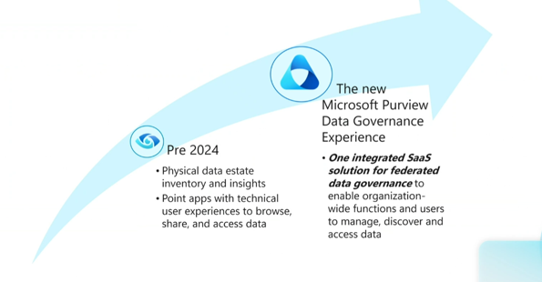
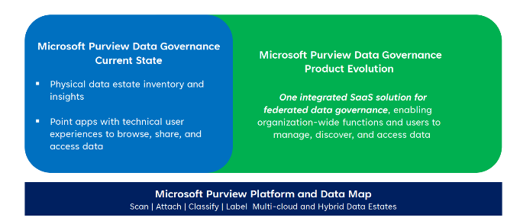

Slide 33
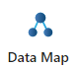
Technical Domains in Data Map It is a construct that allows you to distribute organizational responsibility
Domains provide structure in the data map so domain administrators can maintain the isolation of collections, data sources, scans, and assigned roles for access control. Previously, only collections filled this role, but domains as top-level nodes above the rest of the hierarchy to address a few other scenarios:
Decentralize and distribute responsibility by assigning roles at the domain level.
Create the possibility for hard logical separations within your Microsoft Purview Data Map.
Create consistent management across assets.
Replace multiple accounts within a tenant to multiple domains within a single Microsoft Purview resource.
Tenant
Domain
Domain
Domain
Collection
Collection
Collection
Collection
Collection

